Slide 1
Aircraft Risk Analysis for New Aviation Division
BY SHEILLA KAVINYA MULI

Slide 2
OVERVIEW
Our company is entering the aviation industry with plans to purchase aircraft for commercial and private operations.
The leadership team needs clear, data-driven insights on which aircraft models and manufacturers present the lowest operational risks.
This presentation provides an evidence-based guide to support safe and strategic investment decisions.

Slide 3
Business problem
The company’s expansion into the aviation sector is jeopardized by fundamental lack of expertise in the market and relative safety profiles of various models. Without an objective, data driven analysis of fatal accident rates, dispatch reliability and maintenance costs, the company faces the high risk of acquiring unreliable or unsafe aircraft leading to excessive operational costs, damaging legal liability and catastrophic financial loss.

Slide 4
Project objectives
To analyze aircraft data and understand it
To Identify risk patterns
To benchmark aircraft performance and contextualize it
To recommend the safest models for acquisition

Slide 5
Data sources
Data Source: The data came from historical aviation records which covered incidents, manufactures ,aircraft models and flight purposes
Key Features Examined:
Aircraft model and manufacturer
Purpose of flight (commercial vs. private)
Aircraft age
Incident outcomes (severity
Data Strength : Provides a broad view of safety patterns across time, aircraft categories, and usage types.

Slide 6
Data preparation
The acquired data was handled by doing the following : Data cleaning-removing duplicates and handling missing values
Additionally, it was important to define risk scores; combining frequency and severity of incidents
This step is important because it translates raw aviation data into actionable business insights for safer decision-making

Slide 7
Aircraft Risk Ranking
This analysis ranked aircraft models by incident frequency and severity
Modern, widely used models consistently rank safer while older or niche models appear more prone to incidents
This showed that the safest aircraft models represent the best entry point point for building trusted and reliable fleet.

Slide 8
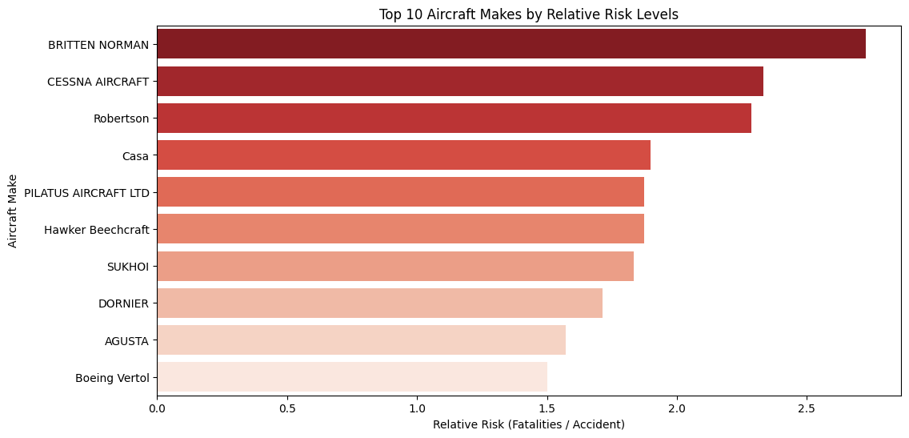
Aircraft models by Relative risk levels

Slide 9
Manufacturer vs Number of Accidents
In this industry, not all manufacturers have the same safety record. The analysis shows clear differences in accident frequency across manufacturers.
Some manufacturers consistently appear in the lowest risk category, while others account for a higher share of incidents
Choosing manufacturers with a proven track record of fewer accidents significantly lowers safety risks and protects risk and protects the company’s reputation.

Slide 10
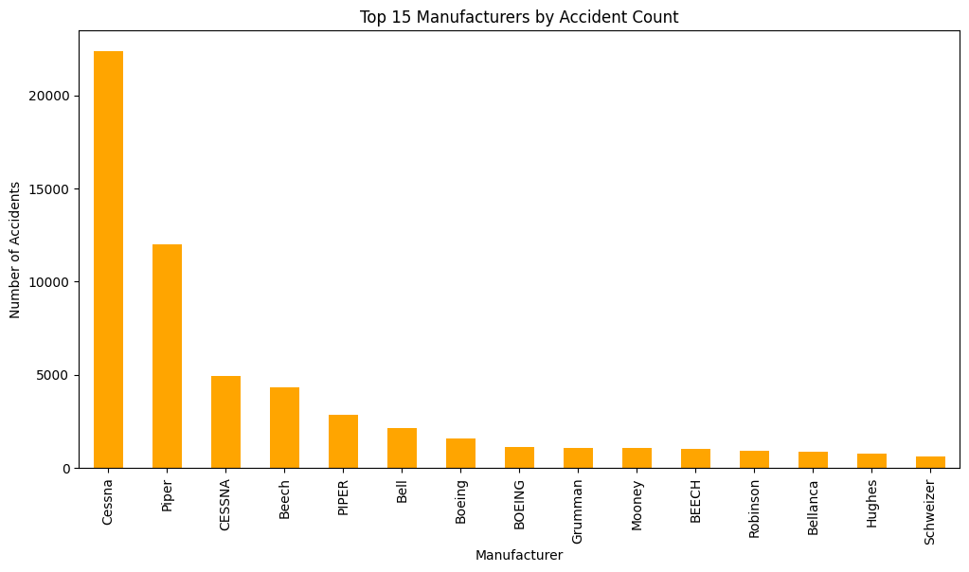
Manufacturer vs Number of Accidents

Slide 11
The Dashboard
After keenly analyzing the data, the dashboard below was formulated to better help the understanding of the data and help make necessary recommendations

Slide 12
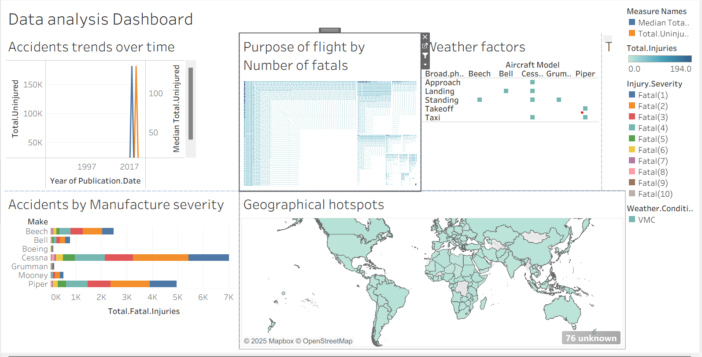
Overall Dashboard

Slide 13
Recommendations
After analyzing the data that was used the following recommendations were made
Prioritize modern aircraft models with the lowest risk scores for acquisition.
Set an age limit on purchases (avoid aircraft older than 15 years).
Partner with manufacturers who demonstrate strong safety in the company’s intended area of operation (commercial/private).
Adopt a continuous monitoring strategy for fleet safety to maintain industry standards.

Slide 14
Limitations and assumptions
Based on historical data future conditions of weather, cost and manufacturer may change
Regional operating differences not fully captured
It also heavily assumed that this dataset reflects industry wide risk trends and that is a big assumption

Slide 15
Next Steps
Moving forward conducting cost benefit analysis to recommend models
It is also important to run a pilot program with small low risk fleet
Additionally we need to monitor safety KPIs and adjust strategy ad needed

Slide 16
Questions
FEEL FREE TO ASK ANY QUESTIONS AT THIS POINT
THANK YOU FOR GIVING ME YOUR ATTENTION.

Slide 17
THANK YOU

